Slide 1
WorkshopPLUS - Windows Server: Vital Signs Part 1
Notes:
Version: 12/21/2018 18:22:55

Slide 2
Disclaimer

Slide 3
Virtual Memory

Slide 4
Learning Units covered in this Module
What is Vitual Memory User Mode What is Virtual Memory Kernel Mode

Slide 5
What is Vitual Memory User Mode

Slide 6
Learnings covered in this Unit
Virtual Memory Concept

Slide 7
Virtual Memory Concept

Slide 8
Virtual Memory Concept
Each process functions in a private, virtual world
Process: “Wow! I have more
memory than I will ever need!
Notes:
Each process is given its own, private, virtual address space, which is a finite amount of virtual memory. This way, the Operating System (OS) can efficiently manage physical resources (RAM and disk—paging files).
virtual memory is not real memory, and it is provided to each process to provide a consistent amount of addressable memory. The virtual address space must be large enough to meet the memory needs of the process.
For the x64 version of Windows and Windows Server, each process is given its own, private 128 TB of virtual memory, regardless of the amount of physical resources on the computer. 32-bit apps are typically given 2 GB of virtual memory

Slide 9
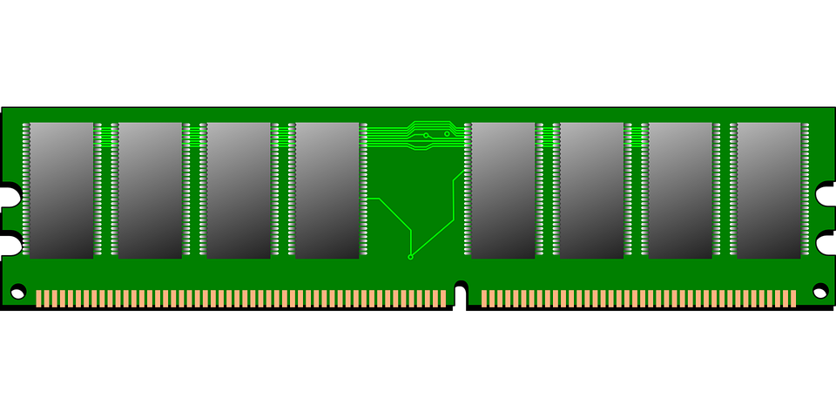
Virtual Memory Concept
Each process functions in a private, virtual world
The kernel manages the real world (physical) resources
Physical Resources
RAM
Disk
Kernel
Notes:
Each process is given its own, private, virtual address space, which is a finite amount of virtual memory. This way, the Operating System (OS) can efficiently manage physical resources (RAM and disk—paging files).
virtual memory is not real memory, and it is provided to each process to provide a consistent amount of addressable memory. The virtual address space must be large enough to meet the memory needs of the process.
For the x64 version of Windows and Windows Server, each process is given its own, private 128 TB of virtual memory, regardless of the amount of physical resources on the computer. 32-bit apps are typically given 2 GB of virtual memory

Slide 10
Virtual world (process)
The process rarely uses 100% of its virtual memory, and wasteful use of memory is common
Virtual memory is private to the process
The process does not run out of memory unless it fills all of its virtual memory
A process cannot exceed its virtual address space
Notes:
A process rarely uses 100% of its virtual memory, and wasteful use of memory is common
Processes (applications) rarely use all of the memory that they reserve. Even a highly skilled application developer might struggle to be 100% efficient with memory. Therefore, by putting the application in virtual memory, the kernel can provide for the needs of the application instead of the wants of the application
If processes could access RAM directly, Windows and Windows Server would need more RAM than they normally do
The virtual memory is private to the process
Each process receives the exact same memory addresses in the virtual memory, but the memory is private to the process
The process does not run out of memory, unless it fills all of its virtual memory
The virtual address space that is given to a process is exceptionally large in relation to the hardware. However, the virtual address space is finite and cannot be exceeded
A process cannot exceed its virtual address space
If a process tries to make a memory allocation that cannot fit within its virtual address space, an out of virtual memory error occurs. This error typically causes the application to crash

Slide 11
Real world (Physical)
Processes are not aware of the physical resources
The Kernel manages the physical resources
Physical resources are used only as needed
The VMM needs to manage only the real memory usage of the processes
Notes:
Processes are not aware of the physical resources
Each process is given the same virtual address space, regardless of the amount of physical RAM on the computer. It all comes down to the amount of memory that processes actually use
The Virtual Memory Manager (VMM) manages the physical resources on behalf of the kernel
The VMM manages the physical resources (RAM and page file) of the computer
Physical resources (RAM and page file) are used only as needed
When a process commits or writes to memory, the VMM provides the process with physical RAM to store the memory. This happens only when a process actually uses the memory. Therefore, the RAM is only used when necessary
The VMM needs to manage only the real memory usage (committed memory) of the processes
The VMM manages the system commit charge (covered in Module 4: Physical Memory), which is all of the memory that the processes and the kernel have committed or written to (in use)

Slide 12
User Mode and Kernel Virtual Memory
Each process points to the same instance of the kernel in the virtual memory
Every process has a private virtual memory for the application (User mode), but the kernel memory is shared between all processes
Notepad.exe
SQLServer.exe
Kernel
(system-wide)
Store.exe
Word.exe
Notes:
Computers running Windows NT use a microkernel architecture, which means that the kernel is resident in every process. This allows threads in the process to transition from User mode to kernel mode.
The virtual address space of every process is divided into User mode and kernel mode. This might seem like there is an instance of the kernel in every process, but the kernel is system-wide. There is only one instance of the kernel, and it is simply referenced inside of the virtual memory of every process.

Slide 13
Virtual Memory for 32-bit Processes
32 bits = 2^32 = 4 GB
User mode and kernel mode are divided equally
Each 32-bit process has a private 2 GB by default
Kernel mode is system wide, and can address up to 2 GB
x86 processors (and some ARM devices) use a 32-bit memory model
32-bit process (default)
System-wide
User mode (2 GB)
Kernel mode (2 GB)
User mode (2 GB)
User mode (2 GB)
Notes:
The largest number that can be represented by 32 bits is 4 GB. This is calculated as 2 to the power of 32 (2^32) bytes.
Back in 1993, when computers had about 8 MB of RAM, Windows NT 3.0 was created for a 32-bit machine and was established with 4 GB of virtual memory per process.
The kernel was given 2 GB, which is system-wide, and each application was given 2 GB.
This was exceptionally large back then. Today, this amount of virtual address space is still used, but typically too small for modern applications and hardware.

Slide 14
Virtual Memory for 64-bit Processes
64 bits = 2^64 = 16 EB
Virtual memory is divided just like 32-bit Processes
Each 64-bit process has a private 128 TB
Kernel mode can address up to 128 TB
x64 Win8.1, WS2012 R2
System-wide
User mode (128 TB)
Kernel mode (128 TB)
User mode (2 GB)
User mode (2 GB)
Notes:
The largest number that can be represented by 64 bits is 16 EB (exabytes). This is calculated as 2 to the power of 64 (2^64) bytes. Advanced Micro Devices (AMD) created the x64 processor architecture, which allows memory access up to 256 TB of virtual address space on current Windows OSes.
256 TB is much lower than the true limit of 64-bit. A 64-bit virtual address space can have up to 16 EB of virtual memory. With such a large amount of memory, it is obvious that today’s computers, as well as tomorrow’s foreseeable machines (at least in the consumer market), are not even close to requiring support for that much memory. Because of that, the current limitation implemented is only using 48-bit, or 256 TB of space. This is divided into User and Kernel mode, thus 128 TB for each.
Windows 8.1 and Windows Server 2012 R2 (and newer) saZhave a hardware requirement for the CMPXCHG16B instruction allowing them to fully use the x64 256 TB virtual address space. Earlier versions of 64-bit (x64) Windows and Windows Server do not have the hardware requirement for the CMPXCHG16B instruction and assume a 16 TB virtual address space.

Slide 15
Memory States
Page: A unit of memory. The default page size is 4 KB
Virtual memory pages are in one of the three states:
Free: A page of memory that has never been used or is no longer in use. A process begins with all memory pages free. It is not backed by RAM or a paging file
Reserved: A page of memory that is intended to be used. It is not backed by RAM or a paging file
Committed: A page of memory that must be backed by RAM or a paging file. Memory cannot become committed until granted by the kernel
Notes:
A page is the granularity in which the MMU (Memory Management Unit) divides the virtual address space for logistics purposes. The default size of a page of memory is 4 KB on x86 and x64 versions of Windows – Itanium processors use 8 KB pages
Virtual memory pages are in one of three states:
Free
Reserved
Committed.
All of the pages of a process’s virtual address space start off as free. There are no hardware resources backing this memory because there is no need to back it. Once a page is reserved, there is still no physical resources consumed to back it, but reserving portions of virtual address space allows the application to protect itself from itself. For example, when a thread is created it requires a contiguous block of stack memory that cannot be broken up.
Committed memory must be backed up by physical resources namely RAM and disk. When an application needs committed memory, it makes a request to the VMM to back the request with physical resources. This becomes a promise to back the allocation—not an actual consumption of resources.
The state of virtual memory pages is controlled by the application. The size of a process’s working set is controlled by the kernel

Slide 16
Reserved and Committed Memory
Process reserved memory:
Memory that is allocated for a process to use, but not committed or written to yet
No physical resources are allocated
Similar to a flight reservation
Process committed memory:
In use memory that is backed by physical resources (RAM and page files)
Physical resources are allocated or guaranteed
Similar to a seat assignment on a flight
I bought my ticket. What do you mean there are no more seats?
Yay! My seat is guaranteed!
Notes:
A page of memory is 4 KB in size. This is the smallest unit of memory that processes and the OS uses to track memory.
Pages of memory are in one of three basic states:
Reserved
Committed
Free
When a process is created, most of the pages of the virtual address space of the process are free. When the application needs memory, it first reserves pages of memory.
For example, if an application developer declares a large array. The array has not been written to, but the application is reserving the memory that is needed to contain the entire array. This is similar to making a reservation with a hotel weeks in advance. Do you think that the hotel immediately cordons off the room as soon as they get the reservation? Of course not. They just make a record of the reservation. Another analogy is to purchase a ticket for a flight—no commitment is made by the airline other than making a note of the purchase. The point is that in all of these cases, physical resources are not used to fulfill the request.
Technically, a memory reservation does require a small amount of physical memory to track the reservation itself, but this amount of memory is relatively trivial.

Slide 17
Effects of Reserved Memory
This is an example of what happens when 100 MB of memory is reserved by an application
No significant changes to the system commit charge, RAM, or page file usage
x64 Virtual address space (128 TB)
System commit limit (RAM+page file): 8 GB
System commit charge:
100 MB reserved
0 MB*
4 GB of RAM
4 GB of page file
* The system commit charge will never be 0, but starting at 0 for the purposes of this example.
Notes:
In the example on the slide, a x64 process creates a 100 MB memory reservation within its virtual address space. Memory reservations are similar to a hotel reservation where the reservation is noted, but not acted upon.
For example, if you book a hotel room one year in advance, the hotel would not cordon off a room right away—the hotel waits until the room is actually needed. The same is true for the VMM, where it will not consume any significant physical resources until the memory is actually needed.
A very small amount of memory is used to describe memory reservations. This structure is called a Virtual Address Descriptor (VAD). To simplify this concept though, a VAD uses no significant memory usage to describe memory reservations.

Slide 18
Effects of Committed Memory
This is an example of what happens when 100 MB of memory is committed by an application
When the commit is granted, the system commit charge increases by 100 MB. No changes to RAM or page file usage
x64 Virtual address space (128 TB)
System commit limit (RAM+page file): 8 GB
System commit charge:
100 MB committed
100 MB
0 MB
100 MB is promised, but not in use
4 GB of RAM
4 GB of page file
Notes:
The process requests the kernel to commit the memory and it is up to the kernel to grant the committed memory. When the commit is requested, the system commit charge is compared to the system commit limit (RAM+all paging files). If the system commit charge can increase to accommodate the requested amount, then the process is granted the committed memory. If not, then the commit is denied. Once committed, the memory is guaranteed to be backed up by physical resources (RAM or disk).
In the example on the slide, a x64 process commits 100 MB. The system commit charge is able to accommodate the 100 MB increase without exceeding the system commit limit, so the commit is granted and the system commit charge increases by the amount requested.
Keep in mind that committed memory is a guarantee to be backed up by physical resources. It does not mean that actual RAM or disk is being consumed. It is certainly possible for the system commit charge to reach the system commit limit, yet still have plenty of available RAM and free space on the paging file—this is where the physical resources are promised out, but not actually used yet.

Slide 19

Exceeding the Virtual Address Space
Each process has a private, virtual address space and cannot exceed it
If an application tries to allocate more memory than it can address, it throws an out-of-memory error that commonly causes the application to crash
Notes:
Virtual memory was never supposed to be a barrier. Back in 1993, 2 GB of virtual memory for each process was exceptionally large when computers had only about 8 MB of RAM. The idea is to have so much virtual memory that you never need to worry about your application running out. After processes started hitting the maximum virtual address space, all of us should have started migrating to 64-bit, to give each process 128 TB. Unfortunately, it is not that easy to simply go to 64-bit, and we are left hitting the limits of the 32-bit address space.
IIS worker processes (w3wp.exe) leak memory if they are poorly written. The 2 GB of virtual memory is not very big anymore, so the 2 GB limit is likely to be hit. If an application tries to allocate more memory than it can address, it throws an out-of-memory error that commonly causes the application to crash. The system is not actually out of memory, but the application is out of virtual memory. Recompiling the application to be 64-bit and putting it on a x64 (64-bit) system gives it 128 TB of virtual memory and prevents it from running out of memory.

Slide 20
Virtual Memory Fragmentation
Memory usage is not 100% efficient and can become fragmented
A process might have plenty of free virtual memory, but fragmentation can cause a memory allocation to fail
New memory allocation
Notes:
Suppose you have a 32-bit process, which has a limit of 2 GB of virtual address space. The process has 1.5 GB of memory reserved and committed, and it has 500 MB free. It tries to allocate a 64-MB contiguous block of virtual memory to use for a new generation 0 for the .NET garbage collector. The allocation fails, and the application crashes with a System.OutOfMemory exception.
First, the system is not out of memory—the application is out of its own virtual memory. The application has 500 MB of virtual memory free, so why does it fail when trying to allocate 64 MB? The problem here is fragmentation. It is natural to assume that all of the memory is nicely sorted and contiguous, but that assumption is not correct. Applications allocate and de-allocate memory as they see fit. Even the best developers, who are managing memory as best as they can, are likely to fragment memory—especially if memory is frequently used.
Here, the 64 MB memory allocation fails because the memory is fragmented and there is not a contiguous block of free memory available. If the process had exceptionally large amounts of virtual memory, it could fragment the memory all that it wanted to without running out, but in 32-bit processes, the memory is too small for modern, memory-intensive applications.
The Microsoft .NET garbage collector (a User mode memory manager) can defragment memory, because it uses rich type information. It can move data and can update all the pointers to whatever it moves, because it knows where all the pointers are.

Slide 21
32-bit Processes on x64 Windows and Windows Server
All processes on a 64-bit OS must be 64-bit processes
Each 32-bit process is hosted by a Windows on Windows (WOW64) process
Kernel mode is no longer in the 32-bit address space allowing User mode to expand up to 4 GB, if large address aware
Notes:
On 64-bit (x64) Windows and Windows Server, all processes must be 64-bit. The 32-bit applications are hosted within a 64-bit process called a Windows on Windows 64 (WOW64) process. In this architecture, the kernel memory is no longer in the 32-bit address space and is in the 64-bit address space. This means that the 32-bit applications can use up to 4 GB of virtual address space. Remember that 2^32 is 4 GB. For a 32-bit application to use more than 2 GB of virtual address space, it must be large address aware. Large address aware is explained next.
The application has the option to commit memory, which asks the memory manager to back the request with physical resources (RAM and page files). Once the memory is committed, the OS has guaranteed that the memory is backed up by physical resources (RAM and page files). This is similar to checking into the hotel or getting a seat assignment from the airline—a guarantee has been made.
Finally, when the memory has been actually written to, the OS maps the virtual memory page to a physical memory page in the RAM. The sum of all of the memory used in this way across the entire system called the system commit charge, which is explained more in Module 4: Physical Memory. This is similar to walking into your hotel room or sitting in your seat on the airplane.
By providing physical resources only to memory that has actually been written to, the OS can use the physical resource much more efficiently.
/LARGEADDRESSAWARE (Large Address Aware) is a process structure header that is compiled into an executable
It makes the 32-bit applications aware of virtual memory beyond 2 GB, when available
Use the DUMPBIN tool from the Windows SDK (or other tools) to check whether an executable supports large address spaces
Dumpbin /headers C:\Windows\system32\smss.exe
Application can handle large (> 2 GB) addresses

Slide 22
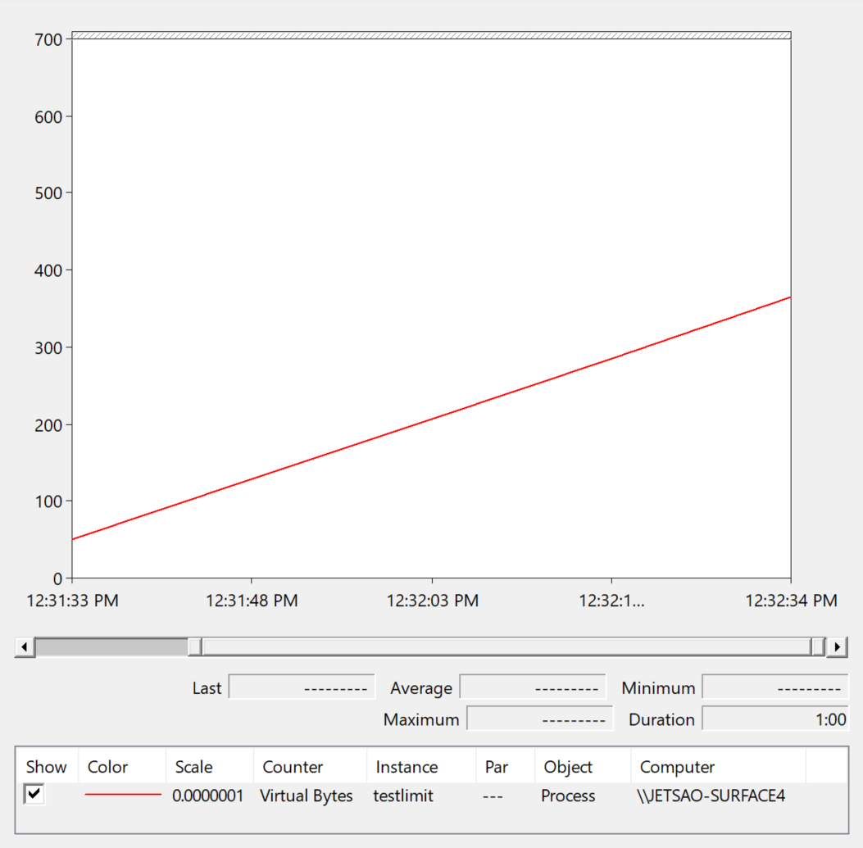
\Process(*)\Virtual Bytes
The \Process(*)\Virtual Bytes counter measures, in bytes, the sum of all reserved and committed User mode memory for a process
Calculate the maximum User mode virtual address space for processes, and compare to \Process(*)\Virtual Bytes
A process reserved memory leak captured in Performance Monitor
Notes:
You can measure the virtual memory usage of each process by using the \Process(*)\Virtual Bytes counter. It measures the sum of all of the reserved and committed User mode memory in the virtual address space of a process.
You can estimate the maximum size of the virtual address space based on the following conditions:
Condition: Maximum size
x86 (default): 2 GB
x86 without /LARGEADDRESSAWARE on a system with the /3GB switch: 2 GB
x86 with /LARGEADDRESSAWARE on a system with the /3GB switch: 3 GB
x86 with /LARGEADDRESSAWARE on a system with the /3GB switch and /USERVA* switch: Same value as USERVA
x86 with /LARGEADDRESAWARE on a system running x64 Windows or x64 Windows Server: 4 GB
X64 Window 8/ Server 2012 and older: 8 TB
X64 Current: 128TB

Slide 23
Thresholds for \Process(*)\Virtual Bytes
Threshold | Effect
0-50% | Informational Normal usage
60-80% | Warning Nearly critical usage. The process might crash, due to fragmentation of virtual memory
80-100% | Critical The process might crash very soon or hang while waiting for memory allocations Exception: Some applications commonly consume all of their virtual memory on purpose, to self-manage it
Notes:
If the counter \Process(*)\Virtual Bytes is greater than 80% of the virtual address space of a process, the process might get an out-of-memory condition soon, which can lead to a crash. Attach VMMap to the process to show the virtual memory fragmentation of the process and to show the largest contiguous block of free memory.
If a 32-bit application crashes frequently because it is out of memory, do one or more of the following:
Enable Large Address Aware on the process header (consult with the application developer on this), and carefully consider the /3GB switch
Migrate to 64-bit
Run the 32-bit application on the 64-bit version of the Windows or Windows Server

Slide 24
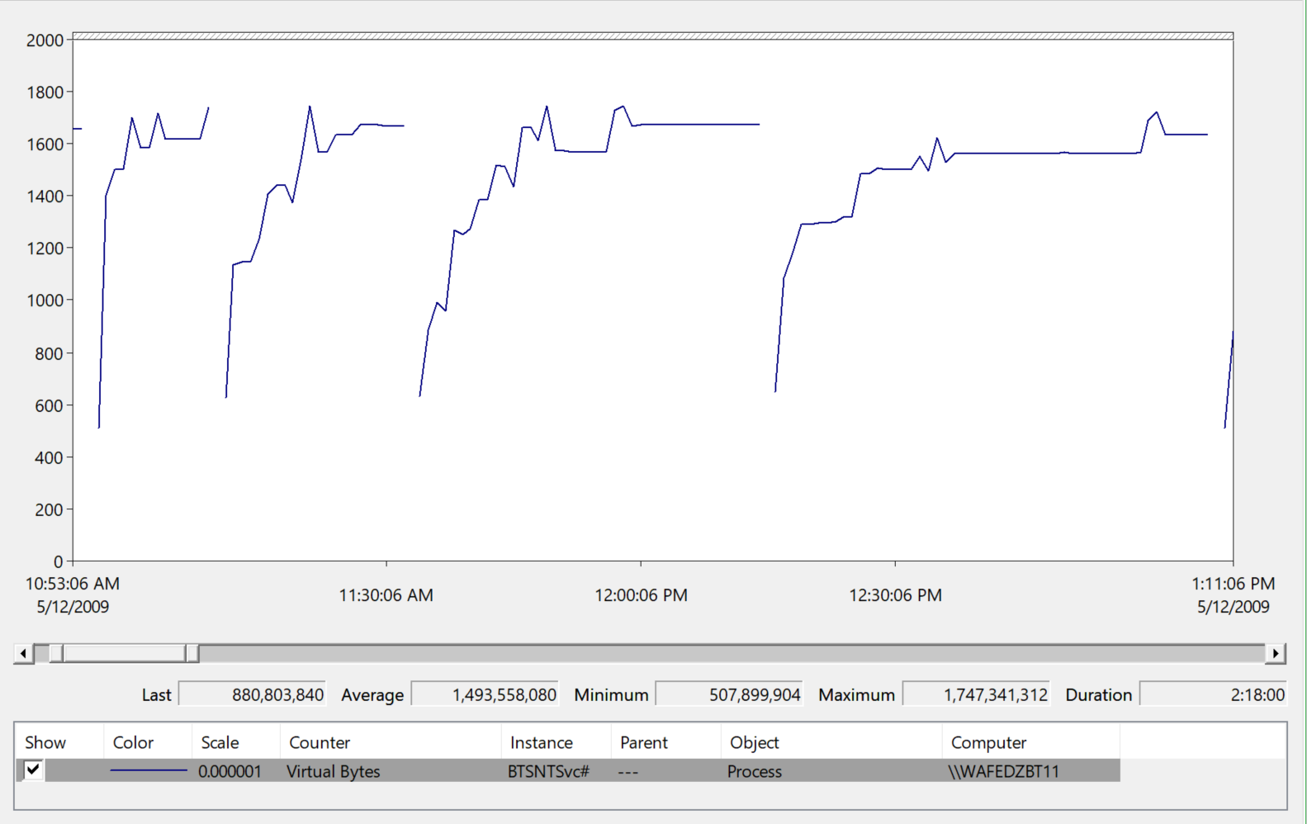
Process is Out of Virtual Memory
Examine \Process(*)\Virtual Bytes for all processes
If a process tries to exceed its virtual address space, it likely crashes with an out of memory condition
CRASH!
Notes:
Compare the \Process(*)\Virtual Bytes counter to the respective User mode virtual address space size of each process.
If a memory allocation fails because it does not have enough virtual memory to satisfy the request, it likely crashes with an out of memory error.
Remember that when a counter instance of the same name (in this case BTSNTSvc) is created, it uses the lowest #n, where n is the lowest number in a series, starting with 1. In this example, the BTSNTSvc#11 process crashes, and then the BTSNTSvc#11 name is reused again and again. This is why the line on the chart appears to be unbroken, even though the process keeps crashing.

Slide 25
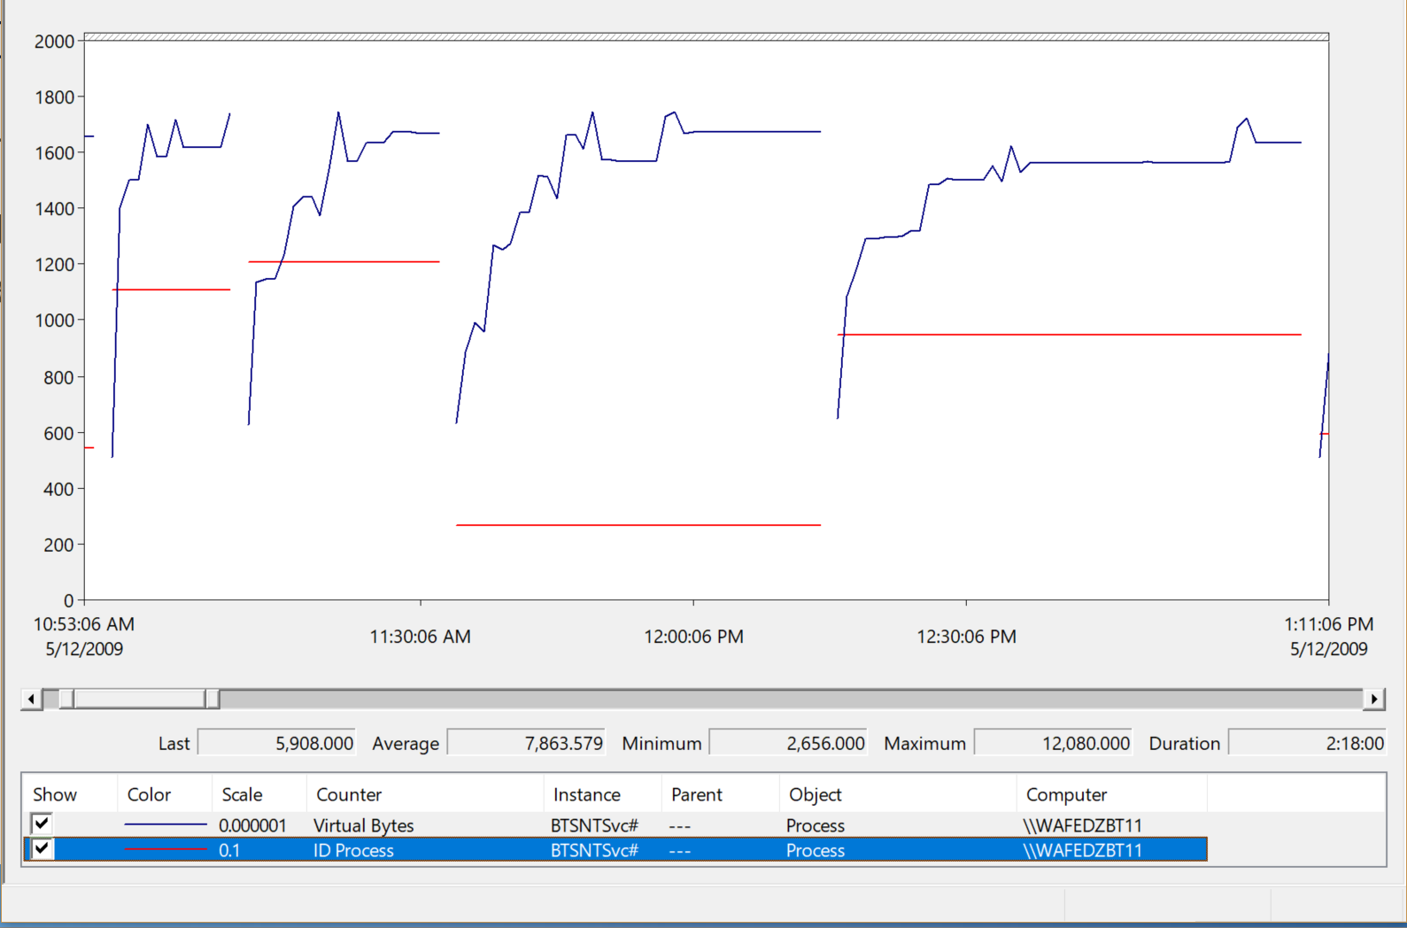
Monitor for Changes in Process ID
Examine \Process(*)\ID Process for the process ID
If ID Process changes for a Process counter instance, it indicates that the process has exited and a new process is reusing the name
New Instances
Notes:
Examine \Process(*)\ID Process for each process respectively. If the value of ID Process changes, it indicates that the process has exited and a new process is reusing the name. This is not an evidence of an application crash, though. To prove that the application crashed, review the Application Event Log, and correlate any crash errors or unexpected termination errors with the ID Process counter value changes.

Slide 27
Should I add more memory to my device?

Slide 28
Knowledge Check
When a process is out of memory, is it out of virtual memory or physical memory?
What happens when a process tries to exceed its virtual memory address space?
Why is it better to have the kernel, instead of the processes, manage physical memory?
Notes:
Question 1 Answer:
When a process is out of memory, it is out of virtual memory. Processes are unaware of physical resources
Question 2 Answer:
A process typically crashes when it attempts to exceed its virtual address space
Question 3 Answer:
The kernel provides processes with the memory they need, instead of want, for better efficiency of physical resources

Slide 29
What is Virtual Memory Kernel Mode

Slide 30
Learnings covered in this Unit
Kernel Virtual memory Layout

Slide 31
Kernel Virtual memory Layout

Slide 32
Kernel Virtual Memory layout
Like applications, the kernel also lives in virtual address space
This address space is split into distinct areas
The kernel can run out of virtual memory in any of the respective areas. Here, the kernel is running very low on Pool Paged virtual memory:
Pool Paged
64-bit (x64) Kernel mode (128 TB)
Pool
NonPaged
System cache, cache bytes, kernel OS, and drivers, etc.
System PTEs
Running critically low!
Notes:
Like applications, the kernel also lives in virtual address space. Unlike applications, the memory of the kernel is system-wide and is shared with drivers. The virtual memory is sub-divided into small regions for things, such as Pool Paged and Pool Nonpaged memory.
In Windows XP, Windows Server 2003 R2, and earlier, Pool Paged and Pool Nonpaged are locked into specific regions and do not change. This means that the Pool Paged memory can become heavily used, and run out of space within its memory region, while at the same time other regions like Pool Nonpaged could have plenty of free memory. This is why it is important to look at each of the memory pools individually.

Slide 33
Pool Paged Bytes and Pool Non-paged Bytes
\Memory\Pool Paged Bytes measures the size, in bytes, of the paged pool. This is an area of system memory used for objects that can be written to the disk when they are not in use
\Memory\Pool Nonpaged Bytes measures the size, in bytes, of the Non-paged pool. This is an area of system memory used for objects that cannot be written to the disk, but must remain in physical memory as long as they are allocated
Performance Monitor cannot measure the maximum size of the Pool Paged bytes or pool Non-paged bytes—other tools must be used
Notes:
Pool Paged and Pool Non-paged are kernel virtual memory pools that are primarily used by drivers. Unlike processes, where the virtual memory is private to each process, drivers must share the memory (ring 0) and must not overwrite the memory of another driver. The most common cause of problems with the kernel memory pool is poorly written drivers
The architecture of the x86 and x64 processors defines four privilege levels, or rings, to help protect system code from fatal crashes, either inadvertently or maliciously by code. Windows uses privilege level 0 (or ring 0) for kernel mode and privilege level 3 (or ring 3) for User mode. The reason Windows uses only two levels is that some hardware architectures that were supported in the past (such as Compaq Alpha and Silicon Graphics MIPS) implemented only two privilege [ring] levels.
Pool Paged memory is used as the primary heap memory for drivers where it is okay to potentially page out this memory to disk.
Pool Nonpaged memory is used as heap memory for drivers where it is not okay to page out to disk. Examples of this might be the disk drivers and highly accessed drivers, such as video drivers.
If drivers were placed in their own memory protection, such as ring 1, the system would be protected from poorly written drivers, but the performance impact of transitioning between rings would be too slow for practical use.
The counters \Memory\Pool Paged Bytes and \Memory\Pool Nonpaged Bytes measure the amount of memory in use by the memory pools respectively. They must be compared to their respective maximum sizes. Unfortunately, Performance Monitor cannot measure the maximum sizes, so other tools must be used.
https://docs.microsoft.com/en-us/windows/desktop/Memory/memory-limits-for-windows-releases

Slide 34
Thresholds for Pool Paged Bytes and for Pool Non-paged Bytes
Threshold | Effect
0-50% (<4 GB) | Informational Normal usage
60-80% (4-8 GB) | Warning(worthy of investigation) Nearly critical usage, which might result in server slowdowns or hangs during peak loads (because all requests are contiguous)
80-100% (8+ GB) | Critical (investigate) Stability or performance issues, and extremely poor application or service performance
Notes:
To account for moderate virtual memory fragmentation, the critical threshold is 80% of the maximum size of each respective memory pool.
Use tools like Process Explorer or WinDBG to get the maximum sizes of the Pool Paged and Pool Nonpaged memory pools (discussed later), and then compare the maximum sizes to the respective performance counters \Memory\Pool Paged Bytes and \Memory\Pool Nonpaged Bytes.
Pool exhaustion conditions (out of Pool Paged or Pool Nonpaged memory) might create System Event Log entries of Srv 2019 or Srv 2020.
If a pool exhaustion condition occurs, carefully consider removing the /3GB switch (if it is not needed), migrate to the 64-bit version of Windows or Windows Server, or identify the resources (usually drivers) that are consuming the most memory. You can use Poolmon.exe (discussed later) to identify the resources that are using the most pool memory.
Common next steps:
Use Process Explorer to discover maximum sizes
Migrate to 64-bit
Use these free Microsoft tools to show kernel pool memory usage:
Poolmon.exe: http://blogs.technet.com/b/markrussinovich/archive/2009/03/26/3211216.aspx
Process Explorer: http://live.sysinternals.com/procexp.exe
See KB article 272568 for more information.

Slide 36
The Case Of Nowhere To Run

Slide 37
Knowledge Check
How do the x64 versions of Windows and Windows Server solve problems in kernel virtual memory?
Which tools show maximum sizes of kernel virtual memory pools?
Which version of Windows and Windows Server has dynamic kernel virtual memory pools?
Notes:
Question 1 Answer:
64-bit versions of Windows and Windows Server have far more virtual address space than 32-bit versions, regardless of physical hardware
Question 2 Answer:
Process Explorer and WinDBG can show maximum sizes of virtual memory pools
Question 3 Answer:
32-bit Windows Vista and Windows Server 2008 have dynamic kernel virtual memory pools

Slide 38
Microsoft

